Slide 1
Budget Airways
Find the cheapest flights for your next trip

Slide 2
Table of Contents
01
02
03
04
Feature List
The Product
The fixed feature list (and the ideas behind them)
The overview of the app and steps of the features
Diagrams
Architecture
Data Flow Diagrams, Flow Charts and more
The Application Architecture

Slide 3
01
Feature List
The list of the features and the ideas behind them

Slide 4
Introduction
When booking trips it is mostly hard to find cheap flights for famous airline carriers.
Most of all, we often forget to save the flight that looked lucrative to us

Slide 5
Introducing
Budget Airways
The application to help find you the cheapest flights and help you bookmark them for your next trip

Slide 6
List of Features
Authentication: Sign In / Sign Up
Flight searcher: search flights from upto 50 cities and up to 100’s of airlines
Flight booking redirection: instantly redirect to the website offering the deal
Flight Watchlist: save the flight that caught your eyes so you can never lose it

Slide 7
02
The Product
An overview of the app

Slide 8
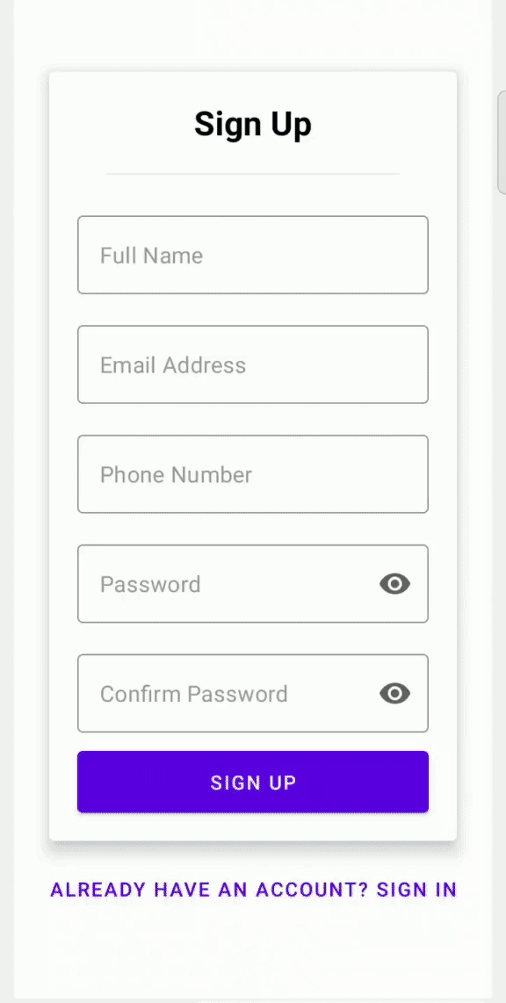
Authentication
(Sign Up)

Slide 9
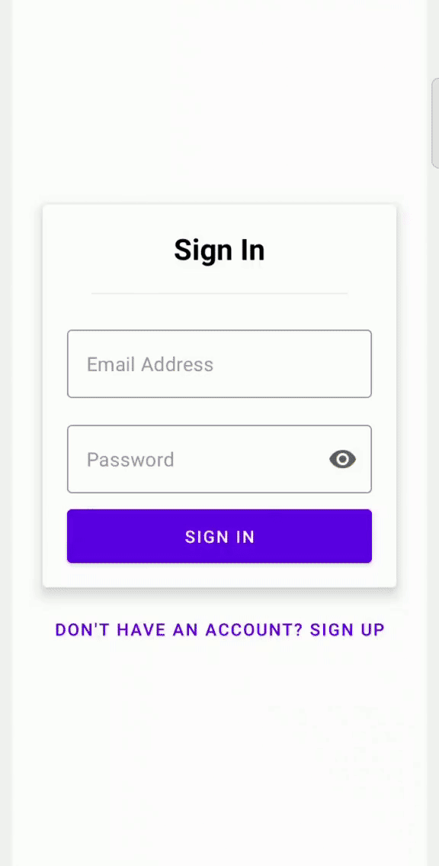
Authentication
(Sign In)

Slide 10
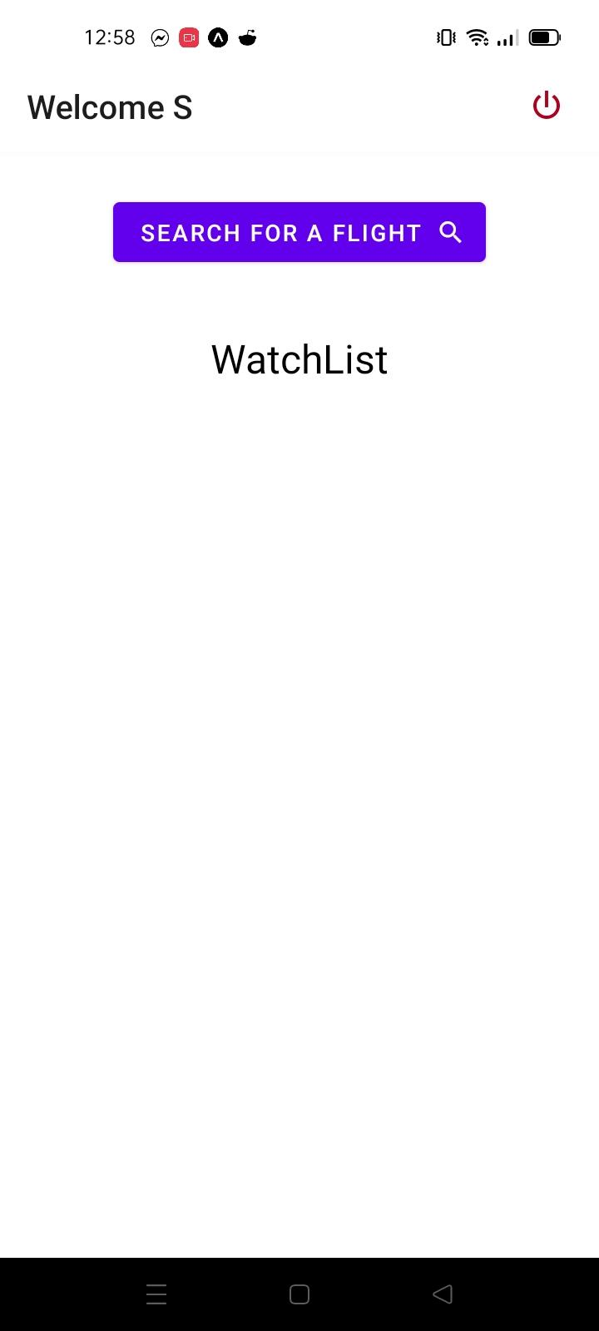
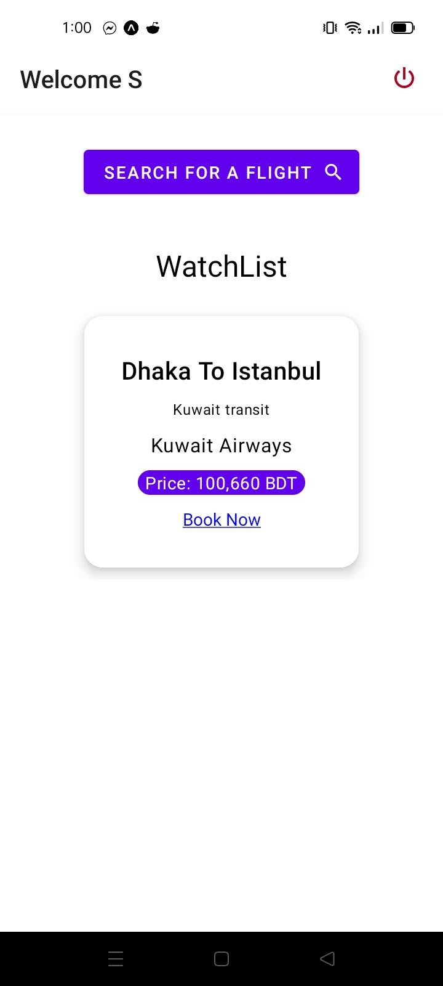
The Homescreen

Slide 11
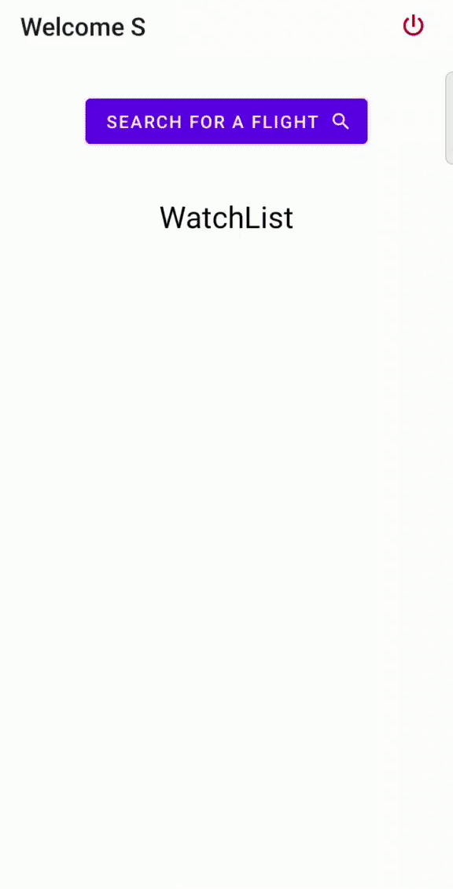
Flight Search

Slide 12
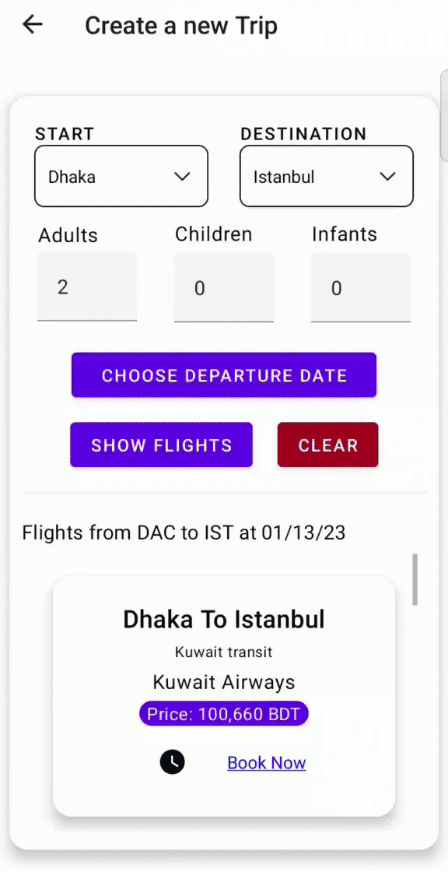
Add to Watchlist

Slide 13
03
Diagrams
DFD & Flow Diagram

Slide 14
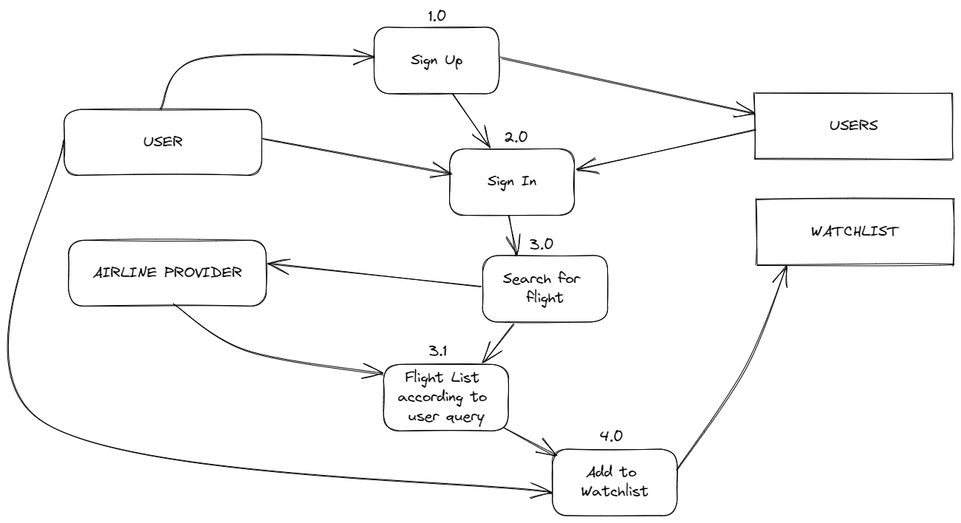
Data Flow Diagram (DFD)

Slide 15
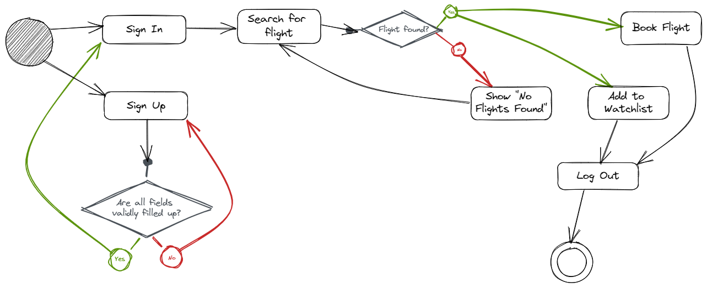
Flow Diagram

Slide 16
04
Architecture
The Application Architecture

Slide 17
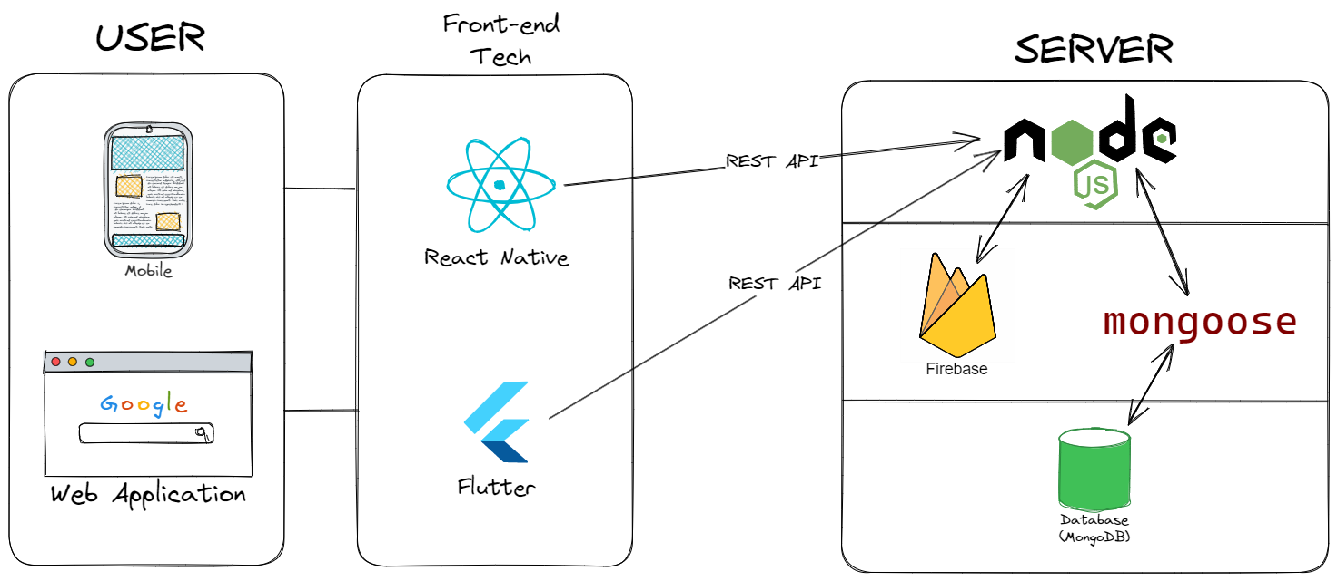
Application Stack

